Slide 1
Analysis of Average State Internet Speeds
By: David Kahn

Slide 2
What is Internet Speed?
You all use it
Phone?
Laptop/Desktop (at home)/Ipad?
But what is it?
Summed up: The amount of data sent to your computer by in an amount of time (usually measured in seconds).
You may have seen:
Kb/s
Mb/s
Gb/s

Slide 3
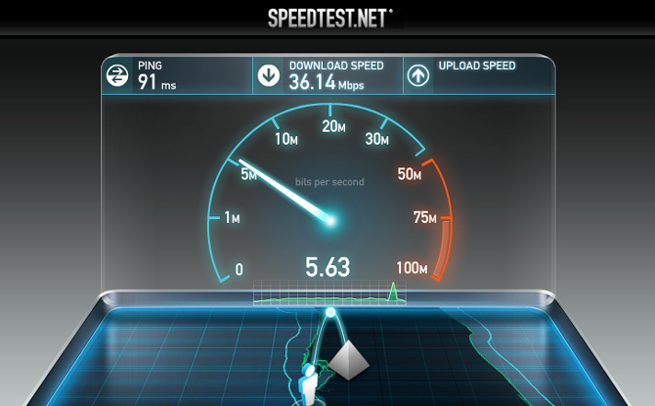
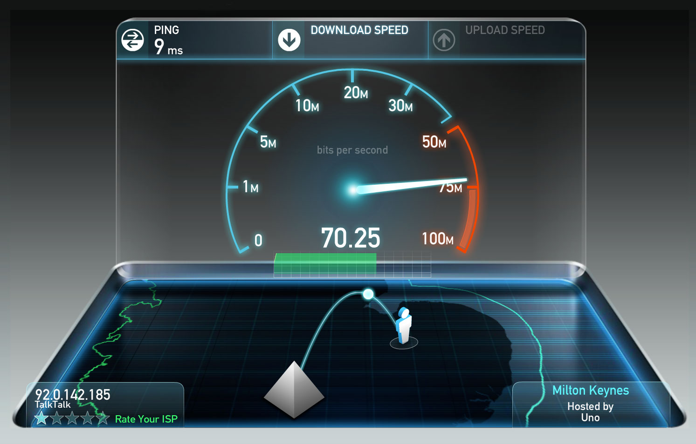
Why is having a higher internet speed, better?
<

Slide 4
What do the average internet speeds of states tell us?
It depends how you look at it
No, not physically, you can stop rotating your head.
Look at 33.4 as a number
What does this mean?
IDK
Look at 33.4 as a question
What is the reason that this speed is what it is?
The interesting part.

Slide 5
Washington's Average Internet Speed
50.6 Mb/s
Idaho’s Average Internet Speed
28.6 Mb/s
Values calculated from data provided at https://www.fcc.gov/general/broadband-deployment-data-fcc-form-477

Slide 6





What could be the reason that Washington has a higher average internet speed?
Technology
Technology
Technology
In Washington, we have a lot of tech companies with large offices
Who need fast internet.
Like… really fast.
Amazon
Google
Microsoft
Expedia
Facebook
These companies impact everyone around them
In a good way

Slide 7

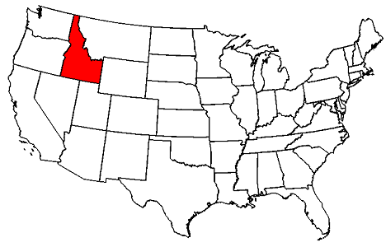
Idaho…
Why a lower speed?
Not as many tech companies
The companies there don’t have giant distribution hubs
Supply and Demand
Not as many people who need fast internet
Geography
Not a very good location

Slide 8
Why is all of this useful?
50.6 > 28.6
Allows us to know a lot about the types and number of companies in each state
Allows us (the user) to determine what factors might be the reason for a lower available speed
Allows Internet Service Providers (ISPs) to know what the average internet speed is needed of each state
Basically, where they should prioritize connection speed
It’s just cool to know

Slide 9
Thank You

